Slide 1
Lunar Lander
By XianYu

Slide 2
INTRODUCTION
The core algorithm of the game is a simulation of rocket motion.
design LunarLander by using MATLAB App to simply emulate the experience of landing a rocket on the moon's surface. This report outlines the key features and functionalities implemented within the game application.

Slide 3
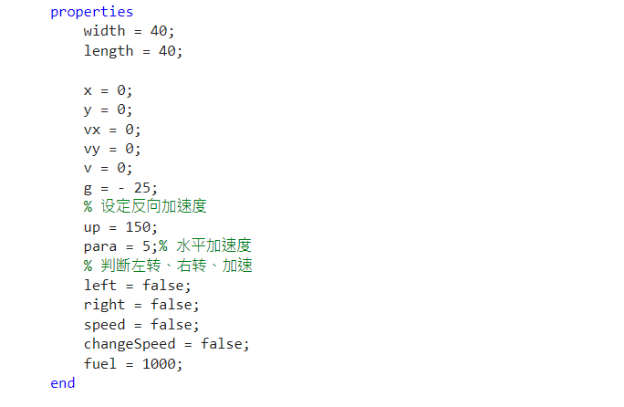
Rocket

Slide 4
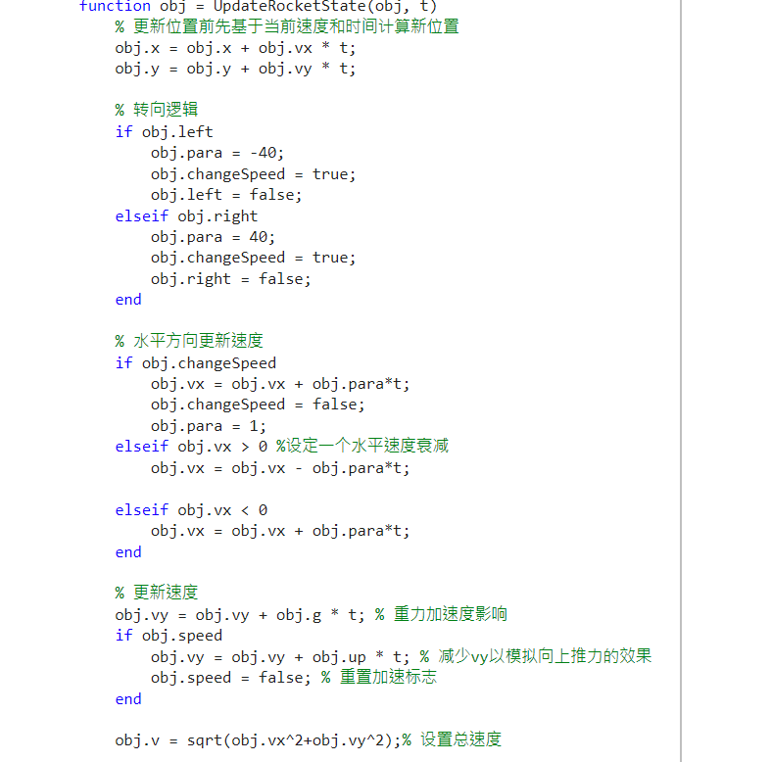
The Simulation Of Rocket Motion

Slide 5
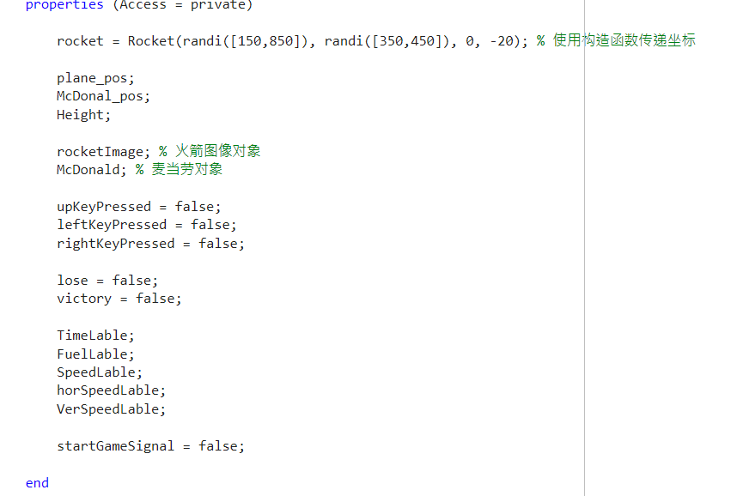
Lunar Lander

Slide 6
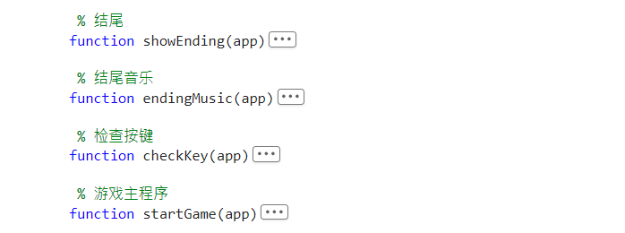
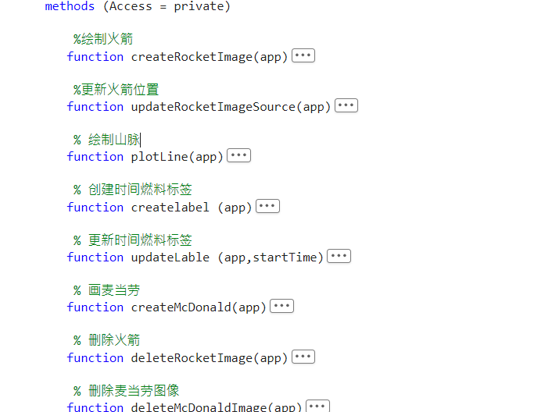

Slide 7
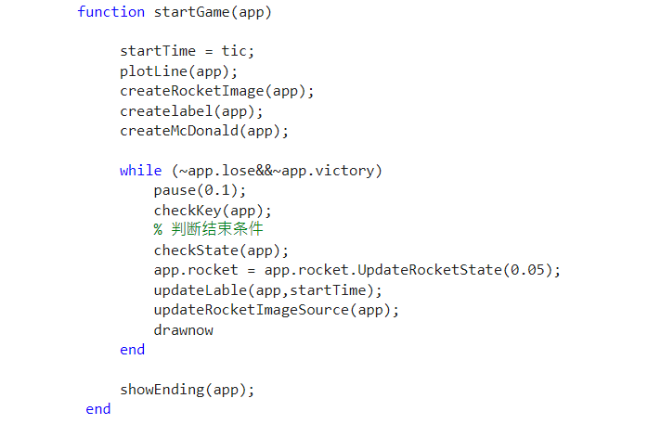
Inside Game

Slide 8
Core Components
UIFigure
Panel
Button
Image
Rocket Management
Terrain Generation
User Interactions
Visual Feedback

Slide 9
Achievement
🗹 The simulation of the rocket motion
🗹 The GUI Interface
🗹 The winning condition check
🗹 More chance to try the game

Slide 10
Lack
🗵 More accurate simulation of the rocket.
🗵 Rotation of the rocket image
🗵 More complicated simulation of the environment include adding some traps

Slide 11
Conclusion
The LunarLander application offers an engaging and interactive gaming experience centered around the challenge of safely landing a rocket on a lunar surface. With dynamic terrain generation, responsive controls, real-time performance indicators, and climactic audio cues, it encapsulates fundamental game design principles in a MATLAB-based environment. This project showcases the versatility of MATLAB in creating visually appealing and interactive applications beyond traditional data analysis and numerical computation tasks.

